Slide 1
BACTERIA ULTRA-STRUCTURE AND ORGENELLS
DR.SONAL MISHRA

Slide 2
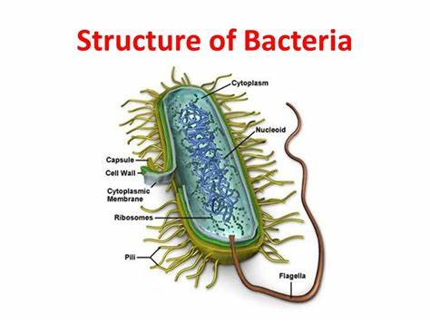
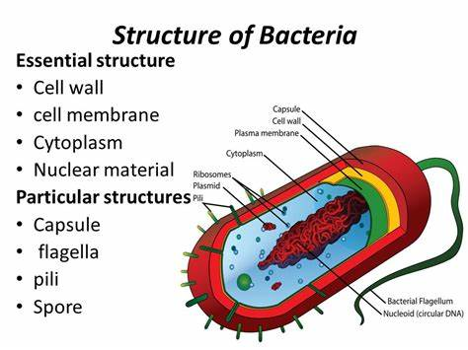

Slide 3
Slime layer and capsule-
Extracellular gelatinous accumulation of viscid materials around the external surface of the cell wall of bacteria capsule.
The bacterial capsule is a very large structure of many bacteria. It is a polysaccharide layer that lies outside the cell envelope, and is thus deemed part of the outer envelope of a bacterial cell.
It is a well-organized layer, not easily washed off, and it can be the cause of various diseases.
When it diffuses into the surrounding medium and remains as a loose undermarcated secretion as in leuconostoc, it is known as slime layer.

Slide 4
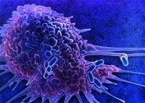
Sticky Bacterial Capsule
Prevents drying out, allows it to attach to other surfaces, prevents it from being engulfed, & shelters it from antibiotics

Slide 5
Function of capsule-
Enhances bacterial virulence by inhibiting phagocytosis. Loss of capsule may render the bacterium avirulent. Bacteria tend to lose capsules repeated subcultures.
Acts as protective covering against antibacterial substance such as, bacteriophages, phagocytes, enzyme etc.
Capsule antigen is specific for bacteria and can be used for identification and typing of bacteria.
Diagnostic importance e. g. Mac-Fadyean reaction in Bacillus anthracis and Quelling reaction in case of pneumococcus sp.

Slide 6
Some eg . of Capsulated gram-negative bacteria:
Escherichia coli (in some strains)
Pseudomonas aeruginosa
Salmonella
Klebsiella pneumoniae
However, some gram-positive bacteria may also have a capsule:
Bacillus anthracis
Streptococcus pyogenes synthesizes a hyaluronic acid capsule.
Streptococcus epidermidis, Staphylococcus aureus

Slide 7
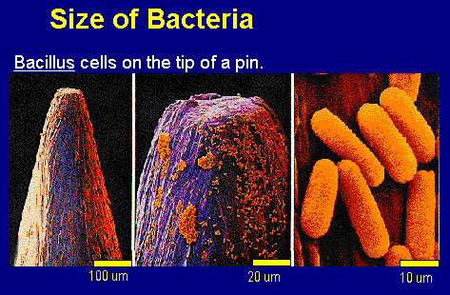

Slide 8
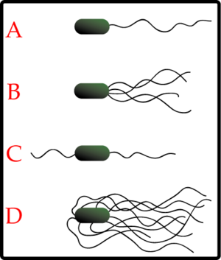
Flagella
Bacteria that are motile have appendages called flagella
A bacteria can have one or many flagella

Slide 9
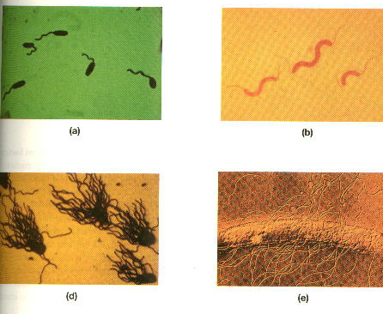
Monotrichous
Lophotrichous
Amphitrichous
Peritrichous

Slide 10
Flagella and Motility-Hair like Helical structure emerge from cell wall.Compsed of flagellin protein and known as H- antigen
Monotrichous, e.g. Vibrio cholerae
2.Amphitrichous e.g. Spirillum serpens
3.Lophotrichous e.g. Bartonella bacillifornis
4. Peritrichous e.g. Escherichia coli
Fuction-
1. It is the organ of locomotion.
2. Motile aerobic bacteria show positive chemotaxis towards higher oxygen concentration.

Slide 11
3. Motility helps in invasiveness as power of locomotion helps in penetrating through epithelial barrier and viscid mucous membrane.
4.Due to continuous changing of place, the rate of uptake of nutrient solvent is increased.
Fimbriae of pili- Some gram-negative bacteria possess another type of filamentous appendages which are numerous, thinner and shorter than flagella.

Slide 12
Fimbriae: Shorter than flagella and straighter , smaller, hairlike appendages . Only on some gram- bacteria.
a). function: adhere. Not involve in motility. One of the invasive mechanism on bacteria. Some pathogens cause diseases due to this (Antigenic characteristic). Prevent phagocytosis.

Slide 13
pili - sex factor. If they make pili, they are + or donors of F factor.
It is necessary for bacterial conjugation resulting in the transfer of DNA from one cell to another.
It have been implicated in the ability of bacteria to recognize specific receptor sites on the host cell membrane.

Slide 14
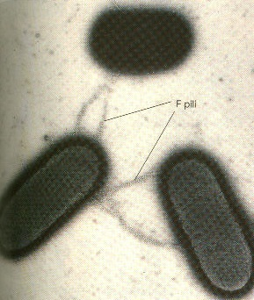
Pili in Conjugation
Hairlike structures that help them attach to surfaces and allow for transfer of genetic material between two bacteria

Slide 15
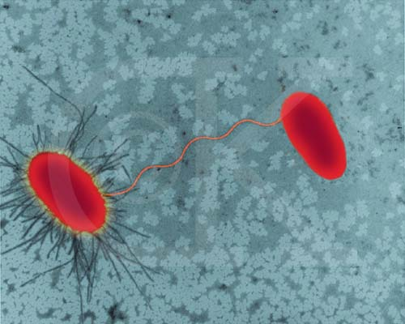
Conjugation in E. coli

Slide 16
b). Origin: Cell membrane
c). Position: common pili , numerous over the cell, usually called sex pile, 1-4/cell
d). Structure: composed of proteins which can be dissociated into smaller unit Pilin . It belongs to a class of protein Lectin which bond to cell surface polysaccharide.

Slide 17
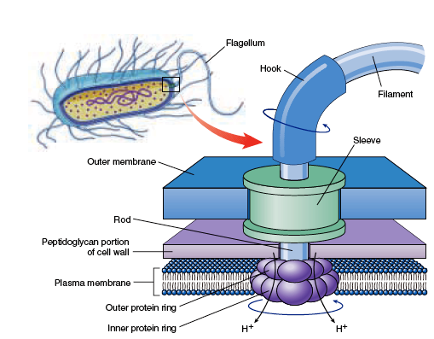

Slide 18
Functions :------
1.Ordinarily pili helps in the adherence of symbiotic bacteria to host cell.
2.Pili helps in the attachment of donor and recipient cells in bacterial conjugation and these pili are called sex pili.
3.It helps in the virulence by acting as a colonization antigens.
4. The majority of fimbriae bacteria adhere to red blood cells of many species causing haemagglutination.

Slide 19
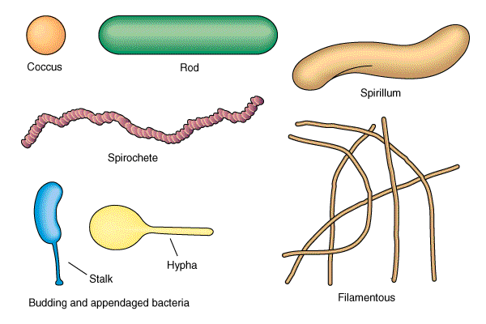
Shapes Used to Classify
Bacillus:
Coccus:
Spirillum:

Slide 20
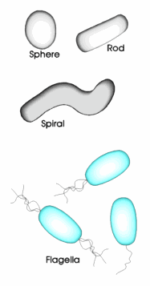

Slide 21
Grouping of Bacteria
Diplo-
Strepto-
Staphylo-

Slide 22
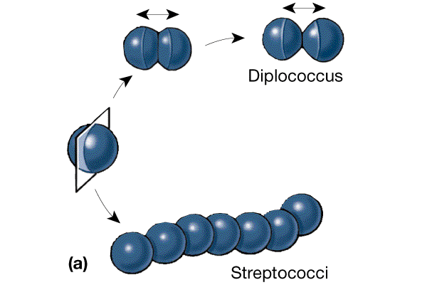

Slide 23
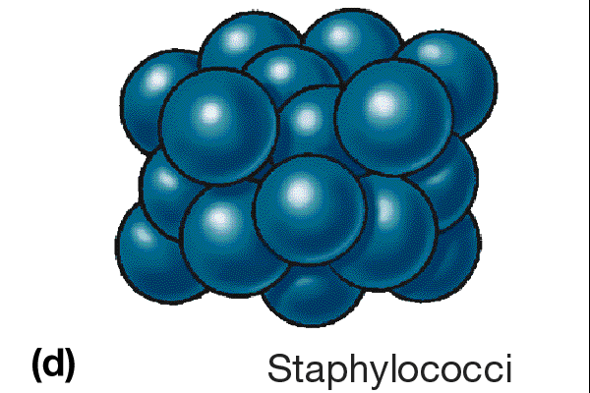

Slide 24
CELL SURFACE LAYER
1. Glycocalyx: Capsule or slime layer
Many bacteria are able to secrete material that adheres to the bacterial cell but is actually external to the cell.
It consists of polypeptide and polysaccharide on bacilli. Most of them have only polysaccharide. It is a protective layer that resists host phagocytosis. Medically important ( Streptococcus pneumonia).

Slide 25
Capsule and Slime layer
The layer is well organized and not easily washed off, it is capsule
Slime layer, unorganized material that is easily removed.
They give mucoid growth on agar plate
B. anthracis has a capsule of poly-D-glutamic acid, while S. pyogenes made of Hyaluronic acid.
Function: Resistant phagocytosis, Protect against desiccation, Attachment to surface of solid objects.

Slide 26
Axial Filaments
Present in spirochetes ( Treponema pallidum cause syphilis)
Function is motility – gliding motility
Bundles of fibrils that arise at the ends of the cell

Slide 27
THANKS

